Slide 1
Active House
Trenton Irwin

Slide 2
Introduction
My Active House project is a complete home monitoring system.
The idea is that you would have one Sensor Hub in each room of your home to collect data.
You would have one Raspberry Pi based base station which all of the sensor hubs send their data wirelessly to.
The base station then sends the received sensor data to the database for use in my app.
Raspberry Pi based base station with an Xbee wireless antenna connected to it.
Arduino based sensor hub which includes the following:
Xbee Wireless Antenna
Light Sensor
Gas Sensor
Current Sensor
Water Flow Sensor
Temperature Sensor
Humidity Sensor
Remote Controllable Light
Buzzer

Slide 3
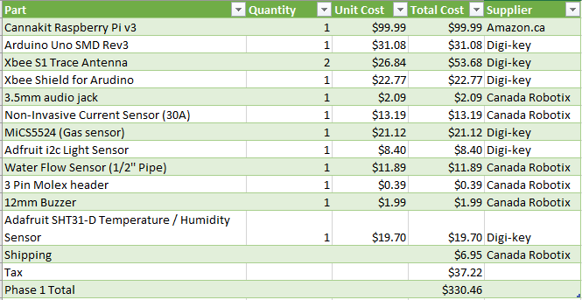
Budget

Slide 4
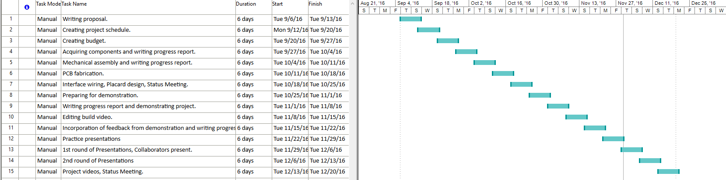
Project Schedule

Slide 5
Knowledge Used From Other Classes
Electronic Devices and Circuits – Soldering experience
Database with Java – Setting up database
Electronic Circuits – Voltage Divider calculations
Technical Workplace Writing – Creating write-ups and technical drawings
Software Engineering – Creating project schedules

Slide 6
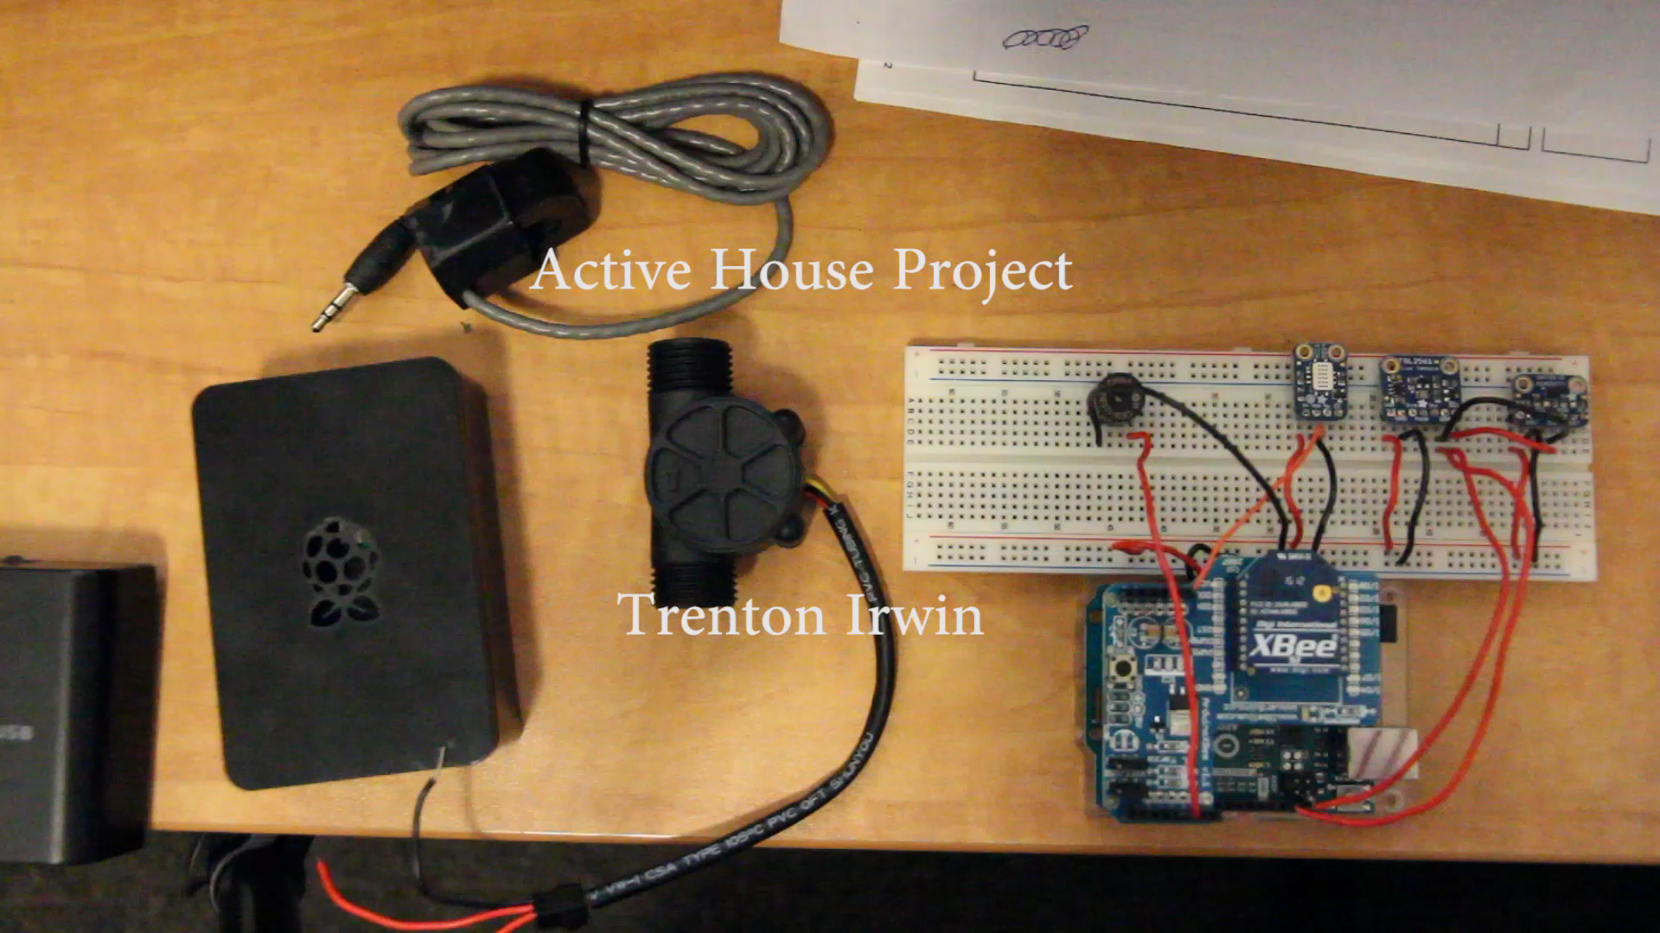
Build Video

Slide 7
Demo Time!

